Slide 1

Help Desk
Feel Free to Ask

Slide 2
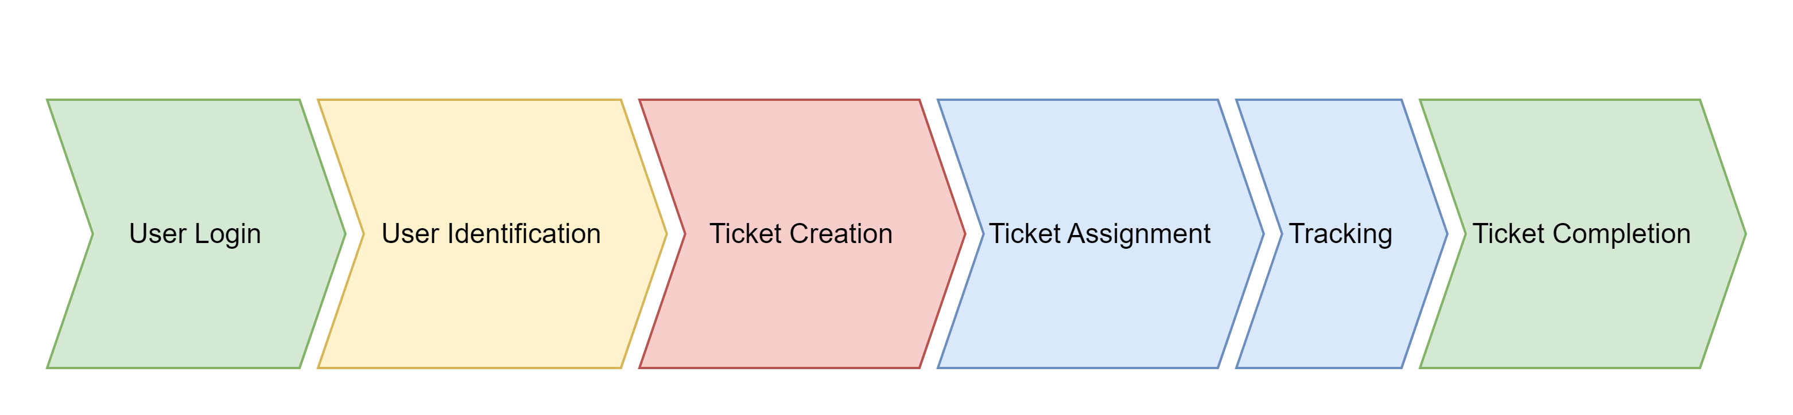
Process Flow

Slide 3
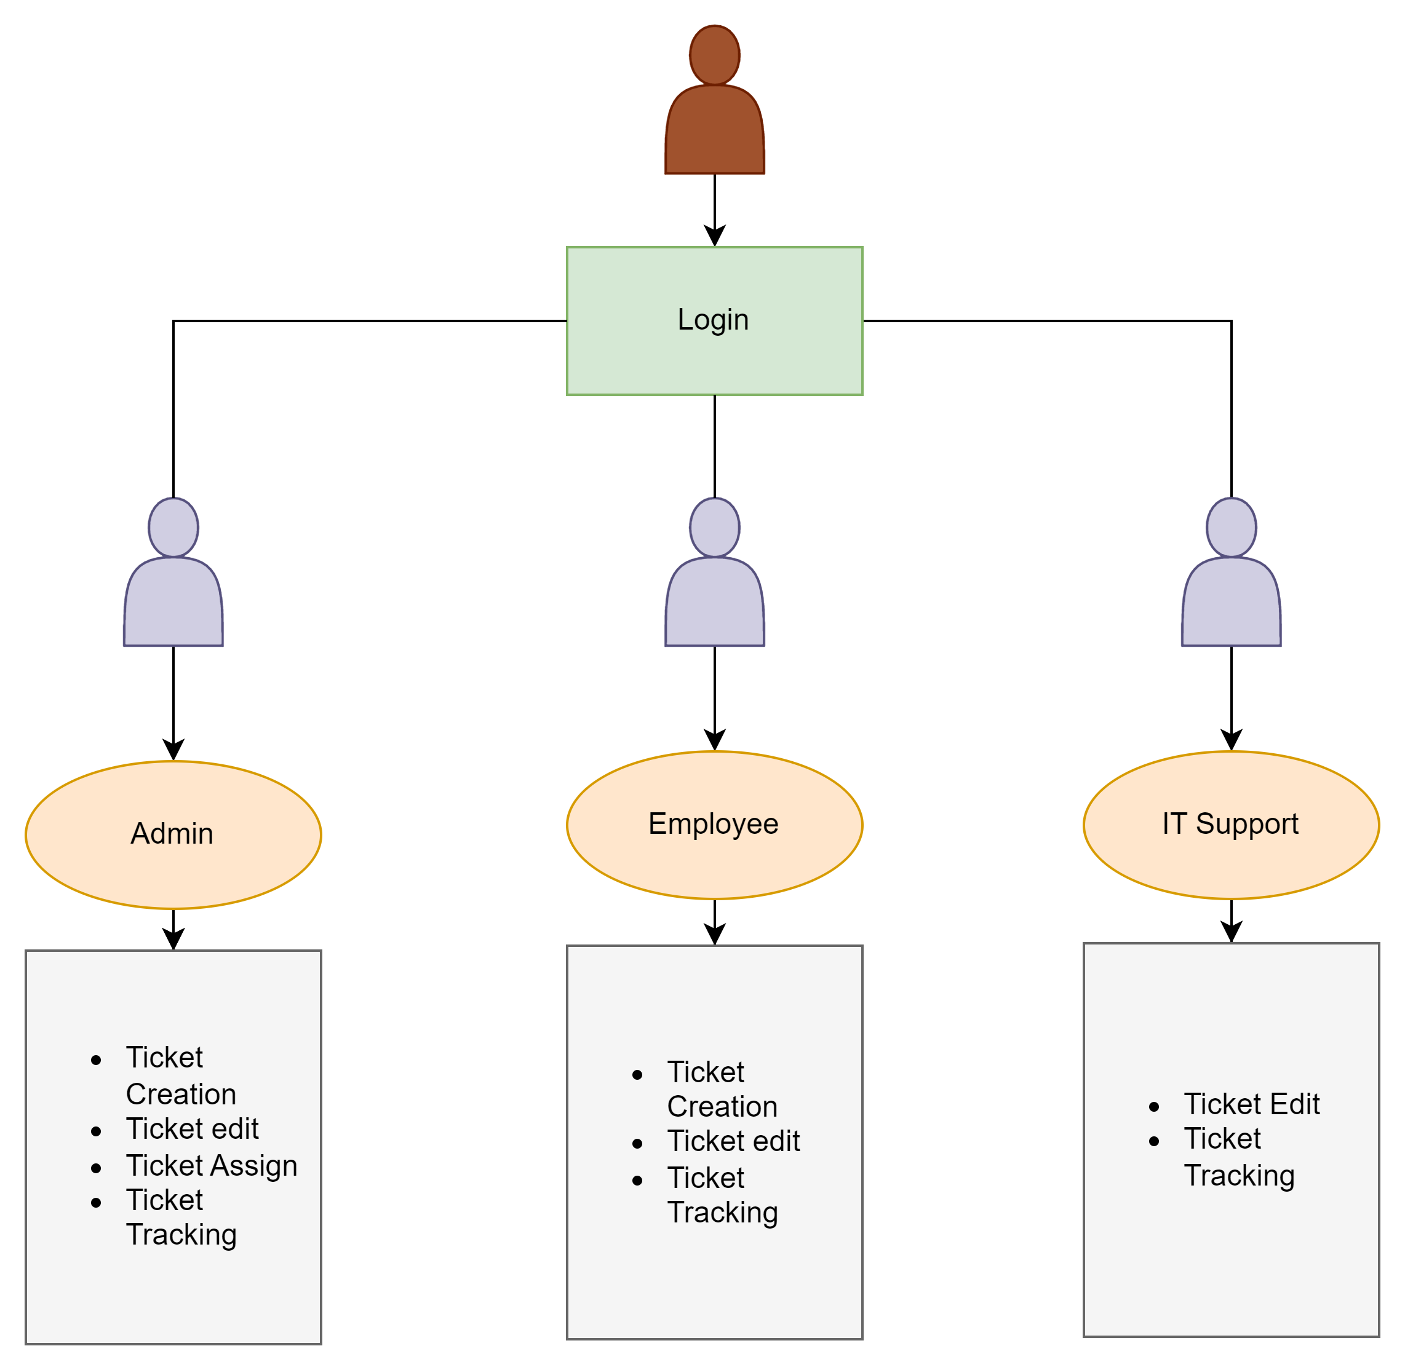
User Access Level

